Slide 1



Department of Artificial Intelligence and Data Science
InFolio: Intelligent Financial Solutions for Enterprises
Guided By Dr.P.Indira priya
Done By A.Karthik(221801023) V.Maiyazhagan(221801032)
Professor

Slide 2
Problem Statement and Motivation
□
Developing a software solution to manage billing,income tracking,expense
reporting and daily expenditure logging for the lodge business ensuring comprehensive financial oversight and efficiency

Slide 3
Objectives
❏ Ensure Accurate Financial Tracking: Provide precise and real-time
monitoring of billing, income, and expenses to minimize errors and enhance
financial oversight.
❏ Streamline Financial Operations: Automate and integrate billing, income
tracking, and expense reporting processes to improve efficiency and reduce
manual effort.
❏ Enhance Financial Reporting: Offer comprehensive and customizable
reports to facilitate better decision-making and financial planning.
❏ Improve User Experience: Design intuitive and user-friendly interfaces
and guests alike, leading to increased satisfaction and engagement.

Slide 4
Abstract
“Inn Folio”offers a comprehensive financial management system designed
specifically for hospitality businesses, addressing the industry's need for efficient, unified financial operations.
The system leverages advanced LSTM machine learning algorithms to automate
key financial tasks such as billing, income tracking, and expense reporting, reducing manual effort and minimizing errors.
By providing real-time data analysis and predictive insights, the system offers detailed financial oversight, enabling better decision-making and strategic planning for hospitality businesses.

Slide 5
Introduction and Overview of the Project.
Streamlined Financial Operations: The software efficiently manages billing, income tracking, and expense reporting through automation and real-time data processing, ensuring smooth financial operations.
User-Friendly Interface: With an intuitive interface and comprehensive reporting tools, the software simplifies invoicing, payment tracking, and daily expenditure logging, making it easy for users to manage finances.
Enhanced Accuracy and Decision-Making: The solution enhances financial accuracy and efficiency, providing actionable insights that support better decision-making for hospitality businesses.

Slide 6
Literature Survey
S.No | Author Name | Paper Title | Description | Jornal | Volume/ Year
1 | Viachaslau Filimonau | The blockchain technology and the scope of its applicationn hospitality Operations | Explores blockchain's benefits and challenges in hospitality, enhancing transparency, security, and supply chain management. | - | 2019
2 | Ineˆs Cruz | International Journal of Contemporary Hospitality Managemen | Combines traditional and new techniques to improve decision- making and strategic planning in hospitality performance management. | International Journal of Contemporary Hospitality Management | 2007
3 | Yusaf H. Akbar, Andrea Tracogna | The sharing economy and the future of the hotel industry: Transaction cost theory and platform | Examines digital transaction systems' positive impact on communication, efficiency, and customer service in Rivers State's hospitality industry. | Innovative Journal of Human Resource and Management | 2017

Slide 7
Literature Survey
S.No | Author Name | Paper Title | Description | Jornal | Volume/ Year
4 | Marianna Sigala | Integration customer relationship Management in hotel operations: managerial and operational | This paper discusses integrating Customer Relationship |  | 2005
 |  | implications | Management (CRM)
 |  |  | with Information and
 |  |  | Communication
 |  |  | Technology (ICT) to
 |  |  | improve customer
 |  |  | retention and satisfaction
 |  |  | in the hotel industry
5 | Prof. Sam Otamiri | WORKPLACE ONLINE TRANSACTION SYSTEM AND | transaction systems impact communication, |  | 2022
 |  | ORGANIZATIONAL HEALTH | operational efficiency,
 |  | OF HOSPITALITY INDUSTRY | and customer service
 |  | OPERATORS IN RIVERS STATE | health in Rivers State's
 |  |  | hospitality industry

Slide 8
Existing System
Manual Processes: Paper-based invoices, receipts, and logs for tracking for transactions.
Generic Accounting Software: Software like QuickBooks or Excel spreadsheets for managing finances, often with limited customization options specific to the hospitality industry.
Multiple Disparate Tools: Separate tools for different functions, such as billing,expense tracking, and reporting, leading to fragmented data management.

Slide 9
Drawback of Existing System
Lack of Integration: The use of multiple separate tools often results in fragmented data, making it challenging to obtain a comprehensive view of the lodge's financial status. This lack of integration can lead to inefficiencies and increased.
Manual Data Entry and Errors: Manual processes and spreadsheets require significant data entry, which is time-consuming and prone to human error. Mistakes in data entry can lead to inaccurate financial reports and decision- making.

Slide 10
Proposed System
Billing Management System: This system handles invoice generation, payment processing, and recurring billing. It ensures that all guest charges are accurately billed, payments are processed efficiently, and any recurring charges are managed seamlessly.
Income Tracking System: This system provides real-time tracking of income from various sources, such as room bookings, services, and events. It categorizes income streams and generates comprehensive reports to help monitor revenue and financial performance.
Expense Management System: This system records and all expenses,from utilities to staff salaries. It includes budgeting tools to monitor expenses against budgets and generates reports to analyze costs.

Slide 11
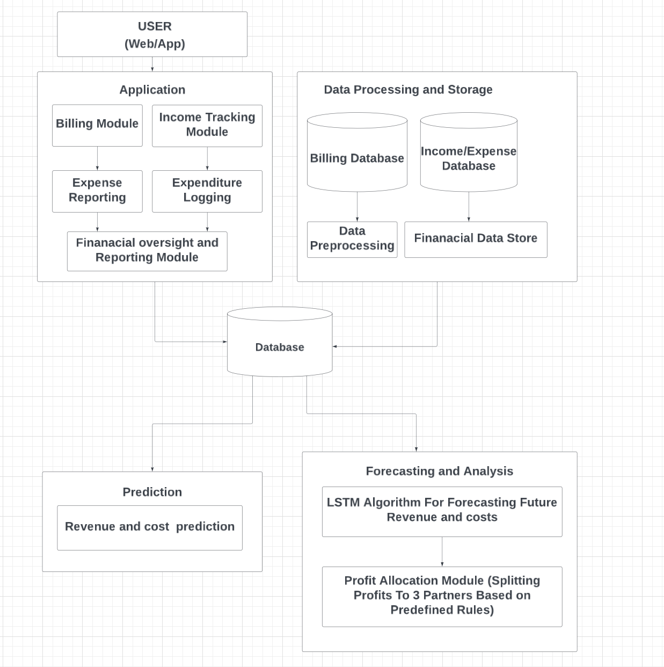
System Architecture

Slide 12
Methodology
Forget Gate: Decides what information to discard from the cell state.
ft=σ(Wf⋅[ht−1,xt]+bf)ft​=σ(Wf​⋅[ht−1​,xt​]+bf​)
Input Gate: Decides what information to store in the cell state.
it=σ(Wi⋅[ht−1,xt]+bi)it​=σ(Wi​⋅[ht−1​,xt​]+bi​)C~t=tanh⁡(WC⋅[ht−1,xt]+bC)C~t​=tanh(WC​⋅[ht−1​,xt​]+bC​)
Updating the Cell State: Ct=ft⊙Ct−1+it⊙C~tCt​=ft​⊙Ct−1​+it​⊙C~t​
Output Gate: Determines the output of the LSTM cell.
ot=σ(Wo⋅[ht−1,xt]+bo)ot​=σ(Wo​⋅[ht−1​,xt​]+bo​)ht=ot⊙tanh⁡(Ct)ht​=ot​⊙tanh(Ct​)

Slide 13
Algorithm
Step 1: Input Processing:Convert the time series data into sequences, where each sequence contains multiple time steps. Normalize the data for consistency, ensuring the values are between 0 and 1.
Step 2: Initialization:Initialize the weights and biases for LSTM cells. Each LSTM cell consists of three gates: input, forget, and output, along with a cell state to store memory.
Forget Gate: Decides what information to discard from the cell state using ft=σ(Wf⋅[ht−1,xt]+bf)ft​=σ(Wf​⋅[ht−1​,xt​]+bf​).

Slide 14
Algorithm
Input Gate: Determines what new information to store using it=σ(Wi⋅[ht−1,xt]+bi)it​=σ(Wi​⋅[ht−1​,xt​]+bi​) and updates the cell state candidate C~t=tanh⁡(WC⋅[ht−1,xt]+bC)C~t​=tanh(WC​⋅[ht−1​,xt​]+bC​). Update Cell State: Update the cell state Ct=ft∗Ct−1+it∗C~tCt​=ft​∗Ct−1​+it​∗C~t​.
Output Gate: Controls the output ot=σ(Wo⋅[ht−1,xt]+bo)ot​=σ(Wo​⋅[ht−1​,xt​]+bo​) and the hidden state ht = ot∗tanh⁡(Ct)ht​=ot​∗tanh(Ct​).
Step 3: Backpropagation Through Time (BPTT): Calculate the loss by comparing the predicted output to the actual values. Adjust the weights and biases using gradient descent by back propagating the error through time across all time steps.
Step 4: Prediction: After training, use the model to predict future values by feeding it the most recent time steps, and accurate forecasting.

Slide 15
List Of Modules
Application
Data Processing and Storage
Prediction
Forecasting and Analysis

Slide 16
MODULE 1 Application
Billing Module: Gather customer information, create invoices, review and send them, log payments, and update financial records.
Income Tracking Module: Collect income data, categorize entries, log daily income, generate reports, and store data.
Expense Reporting Module: Record expenses with receipts, categorize them, validate entries, approve expenses, and generate reports.
Expenditure Logging Module: Log daily expenses, categorize them, verify entries, summarize data, and update financial records.
Financial Oversight and Reporting Module: Collect financial data, analyze it, create reports, visualize trends, and share reports.

Slide 17
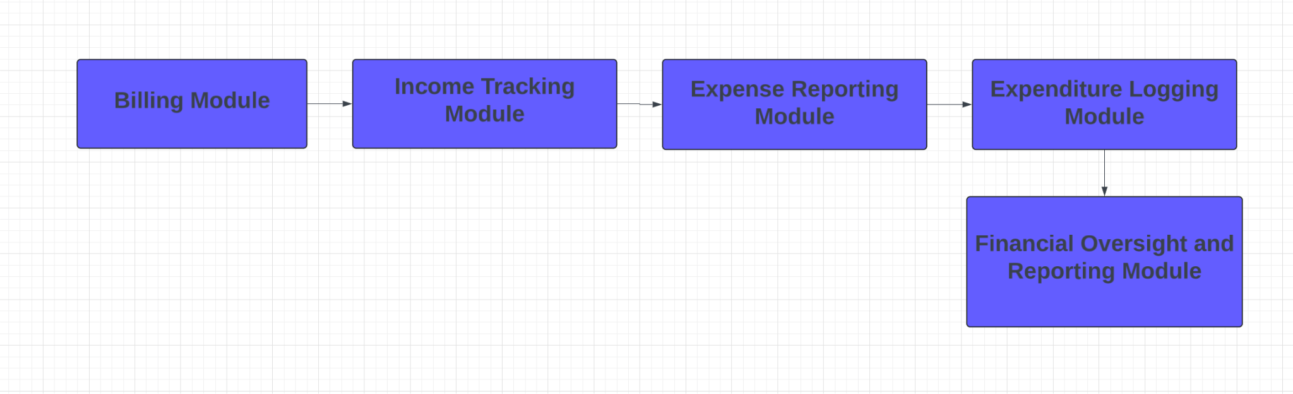
Data Flow Diagram

Slide 18
MODULE 2 Data Preprocessing And Storage
Collect and Clean Data: Gather raw data from all sources and remove errors and duplicates.
Transform and Validate Data: Convert data into a standard format and ensure accuracy.
Store Processed Data: Save the cleaned data in a structured database.
Organize and Secure Data: Arrange data for quick access and protect it with encryption and access controls.
Backup and Archive: Perform regular data backups and archive older data to maintain performance.

Slide 19
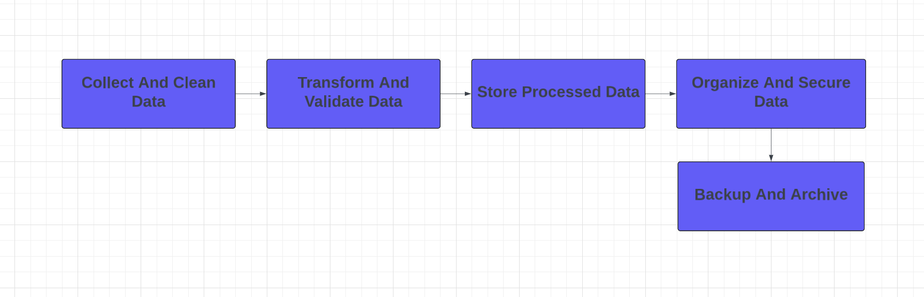
Data flow Diagram

Slide 20
MODULE 3 Forecasting And Analysis
Collect Historical Data: Gather past financial data for training and analysis.
Prepare Data for LSTM: Clean and transform data into a suitable format for the LSTM model.
Train the LSTM Model: Use the prepared data to train the model for forecasting.
Validate Predictions: Test the model's accuracy and adjust as needed.
Profit Allocation: Extract total profits, apply sharing rules, calculate partner shares, and generate reports.

Slide 21
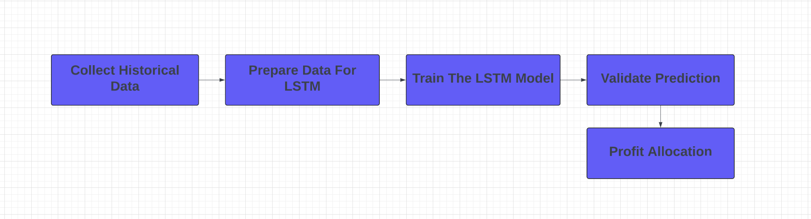
Data Flow Diagram

Slide 22
MODULE 4 Prediction Layer
Collect Historical Data: Gather past revenue and cost data for analysis.
Clean and Prepare Data: Remove errors and format data for model training.
Train Prediction Model: Use the prepared data to train a revenue and cost prediction model.
Validate Predictions: Test the model’s accuracy and make adjustments.
Store Prediction Results: Save the predicted results for future analysis and reporting.

Slide 23
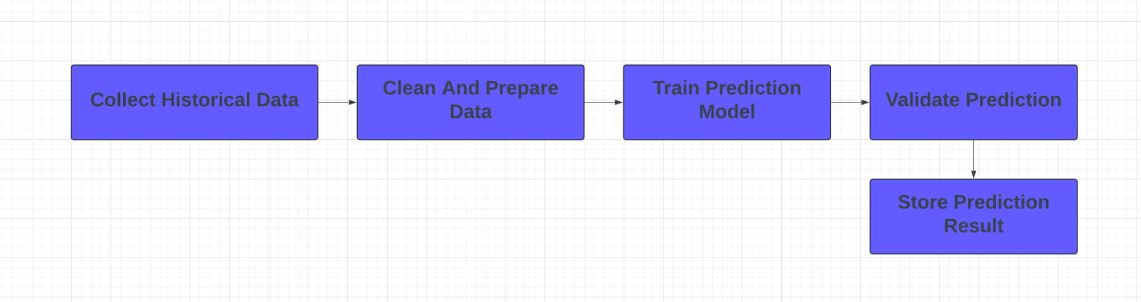
Data Flow Diagram

Slide 24
Result And Discussion
Results
Accurate Forecasting: Predicted future revenue and expenses reliably.
Strong Performance: Achieved low error rates in validation tests.
Complex Pattern Handling: Effectively managed non-linear trends in data.
Discussion
Limitations: Required significant data and computational resources.
Practical Implications: Improved budgeting and profit allocation processes.
Future Improvements: Enhancing accuracy with external data factors.

Slide 25
Conclusion
LSTM is highly effective for financial forecasting, handling complex patterns better than traditional models.
It provides accurate, reliable predictions, improving financial decision-making.
Requires large datasets and significant computational resources.
Best suited for organizations with sufficient data and resources.
Offers valuable real-time adaptability for dynamic financial environments.

Slide 26
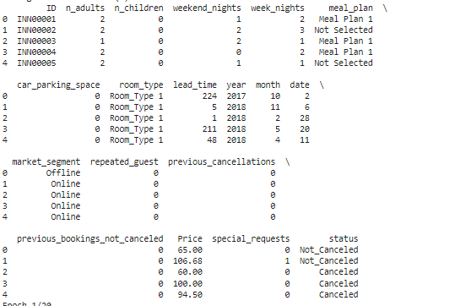
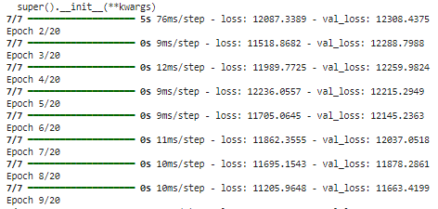
OUTPUT
Data Processing and Storage Layer

Slide 27
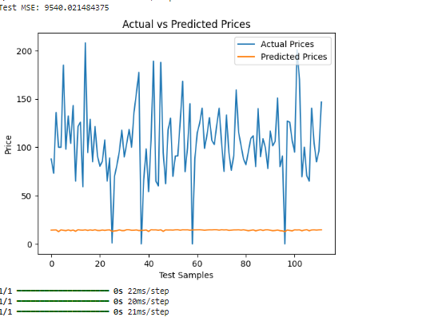
OUTPUT
Prediction Layer

Slide 28
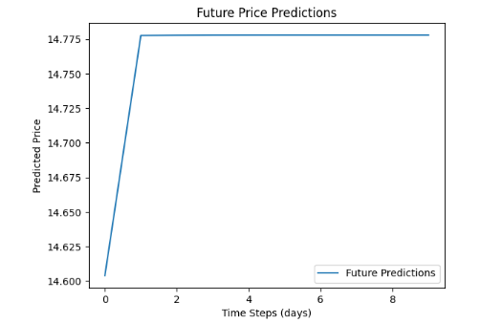
OUTPUT
Forecasting and Analysis Layer

Slide 29
List Of References
Thakur, R., & Shrivastava, A. (2021). "Financial Management in the Hospitality Industry: A Study on Technology Integration." Journal of Hospitality Financial Management, 29(1), 45-58.
Gursoy, D., Chi, C. G., & Chi, O. H. (2022). "The Role of Financial Management Practices in the Success of Small and Medium Lodging Businesses." International Journal of Hospitality Management, 99, 103066.
Kim, S., & Lee, S. (2023). "The Impact of Real-Time Data Analysis on Financial Decision-Making in the Hospitality Sector." Journal of Hospitality and Tourism Technology, 14(2), 156-174.

Slide 30
Thank You
Zeroth Review

